Slide 1
The Royal Society of Biology North Western Branch
Nature Quiz
Devised by : Michael Clapham MSc C.Biol FRSB

Slide 2
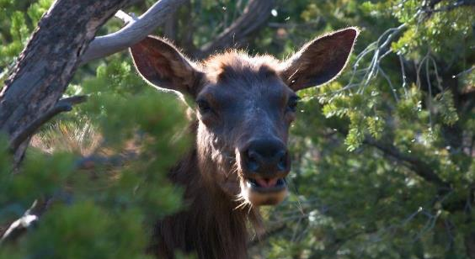
Instructions
Nature Quiz!
In this slideshow the questions appear before the photographs, although suggestions for responses are included in the final slides of the PowerPoint any reasonable response should be acknowledged.
This quiz can ,therefore, be used with any age group and from any background and is an excellent opportunity for biological debate and engagement.

Slide 3
Question 1
1 Point
The first two slides show a deer species found in the USA, its an elk or “waapiti’’, Cervus elaphus canadensis (a sub-species of the red deer found here in the UK!)
Waapiti means “white rump”, the reason for which is evident from the second slide. You will also notice that the mule deer, subject of question 2, also has a white rump; this is a common characteristic of deer. It clearly detracts from the camouflage of the deer and can make it easier to spot, so can you suggest a use that outweighs this risk and may explain how it evolved?

Slide 6
Question 2
1 Point
Slide 3 shows a mule deer Odocoilus hemionus. It is a prey animal. There are several predators in its habitat in the USA that could make a meal of this deer.
Wolves hunt in packs and rely on stamina to chase their prey down. Lynx are lone hunters who rely on stealth to approach close to their prey before pouncing. Bears are heavy and powerful and rely on short bursts of speed to catch their prey.
Which predator do you think is of particular risk to this deer and give a reason for your answer?

Slide 8
Question 3
1 Point
The deer species from Q1 and 2 have ‘antlers’ which grow new each year and are shed after the breeding season, this next animal is a large antelope, a male Kudu from Africa, Tragelaphus strepsicerus, it has ‘horns’ which are never shed and stay with the animal all of its life. These impressive horns consist of a bony core covered by a keratin ‘sheath’. Soon after death the sheath becomes ‘detached’ from the core, and in the straight horns of some antelopes, this sheath can be removed and replaced easily like a dagger in a sheath.
Observe the slide and decide whether or not you think the keratin sheath of the Kudu’s horns can be removed and replaced in the same way. To get the point give a reason for your decision based on the exact shape of the horns!

Slide 9
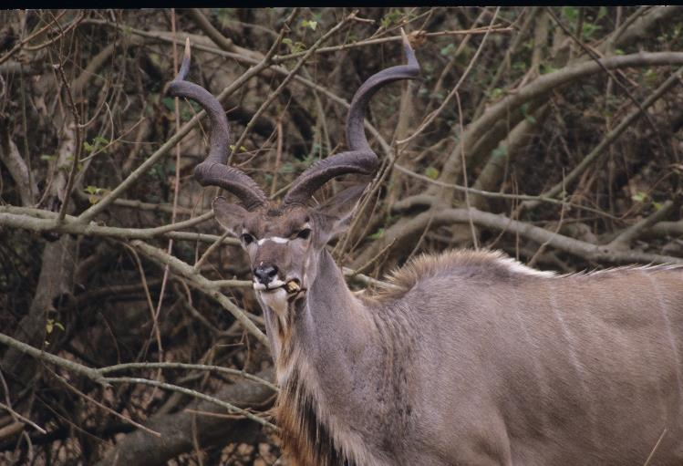

Slide 10
Question 4
Here you see a small bird, it is a rock wren Salpinctes obsoletus. It lives only in rocky canyons and cliffs, here it is in the Grand Canyon USA. It nests in crevices and uses mainly small stones/pebbles to construct the nest. It expends a lot of energy carrying hundreds of small stones to the site. It ‘paves’ the inside of the nest, filling in all the crevices and making a level floor. It then builds a stone wall across the entrance up to 6 cm high. It then “paves” the area outside the nest crevice with flat, loose stones. This behaviour is unique!
Suggest 2 advantages the stone wall may provide (2 Points)
Suggest why paving the inside of the nest makes it safer for the chicks (1 Point)
Suggest why paving the outside area may provide safety from predators (1 Point)
Suggest why paving the outside area may be an advantage when the bird returns to the nest area each spring (1 Point)
This bird lives in arid rocky areas with little water. It never drinks water. Give 2 sources for water that it must therefore use. (2 Points)

Slide 11
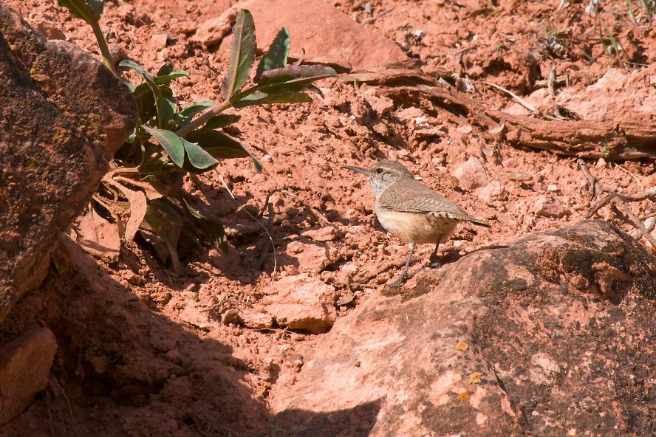

Slide 12
Question 5
1 Point
You have 10 seconds to view the next slide and say what animal you saw hiding among the leaves on the forest floor in the Amazon …

Slide 14
Question 6
2 Points
This is a Little Raven (Corvus mellori), on Mount Kosciuszko in Australia, it is a common bird on the mountain. It is insectivorous. In summer it relies on a moth, the Bogong Moth (Agrotis infusa), for a substantial part of its diet. This moth has a large body rich in fat (60% by weight).
Many thousands of these moths spend the summer hiding in cool crevices among the granite rocks on the mountain heights. The ravens and aboriginal peoples are able to feast on them all summer long. The moth numbers are huge, far in excess of what could be produced on the mountain given the cool temperatures, low growth rates and small stature of the plants. In early summer millions of these moths can be found covering buildings in cities 1,000km away which lie between the lowlands and the mountains.
Can you explain these facts?

Slide 18
Question 7
1 Point
The next slide is of a grey seal (Halichoerus grypus) photographed on a British beach in December. The young pup is suckling and has its mother to defend it from predators. The females give birth to their pups on offshore sand banks or isolated rocky beaches below tall cliffs.
You may fairly conclude from the next two slides, taken on a snowy winters day, that this seal pup (with no parent present), has little fear of humans and shows no aggression. Most other young mammals would attempt to get away or bite or hide from the photographer who is after all a large potential predator. Suggest why grey seal pups have not evolved this defence response.

Slide 22
Question 8
1 Point
You have 3 seconds to view the next slide then say exactly what animal you saw.

Slide 24
Question 9
1 Point
The next 4 slides show you two plants from South Africa, the first is a shrub, the impala lily, Adenium multiflorum and then a tree, the coral tree, Erythrina lysistomon.
They both have brightly coloured flowers to attract pollinators. What characteristic visible on the slide, which is the same in both these plants, increases the effectiveness of these attractants and does not relate to colour?

Slide 29
Question 10
In the next slides you see a leopard, Panthera pardus, a giraffe, Giraffe camelopardalis, and two zebra, Equus birchelli. All are distinctively patterned. The genes that generate the patterns are essentially identical in all three species and are equally capable of generating spots, stripes or patches. The actual pattern is fixed at an early stage in embryo/foetal development when the relevant genes are switched on and the pattern develops due to the spread of certain reactive compounds through the developing skins.
Considering only the three species shown here can you suggest how the same genes producing the same chemicals released into the embryo skin of all these species leads to completely different patterns once the gene is switched on? Think of the embryo/foetus and the control of the gene! (2 Points)
What physical process could cause compounds to spread slowly through the skin of an animal embryo/foetus from isolated release sites. (1 Point)

Slide 33
Question 11
Here are questions about a bird that can do something rmarkable, It can hover and move in any direction, even backwards!
This is a sombre hummingbird (Aphantochroa cirrochloris) feeding on nectar in Amazonia, Brazil. Its flight muscles use a massive amount of energy and the bird must feed almost continually in daylight hours to supply sufficient food. They cannot fly at night and therefore cannot feed. They also have a very high body temperature of 40°C, this also requires an enormous amount of energy to maintain.
When roosting at night the bird goes into torpor, an almost ‘death like’ state where metabolic activity is reduced by up to 94%, and their body temperature drops by up to 20°C.

Slide 34
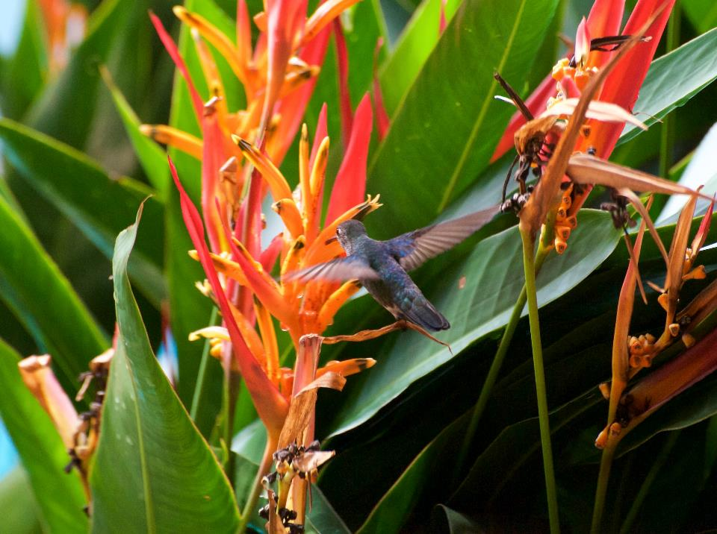

Slide 35
Question 11
When perching in torpor (or notivation) at night they are not able to respond to their environment; you could prod a sleeping humming bird with your finger but it would not respond. Yet they do not fall off their perch, which is most often a small, thin branch. They have a special evolutionary adaptation to keep them on their perch.
A. If they did not go into torpor they would certainly die during the night. Why? (1 Point)
B. Can you suggest what keeps them on their perch and explain how it works? (3 Points)
In the morning when the bird awakes it must warm its body rapidly. It cannot rely on the sun, this would take too long, they need to feed as soon as possible.
C. So what does it do? (1 Point)

Slide 36
Question 12
2 Points
Next you see the ‘Walking Palm’ (Socrata exhorrhiza) found in Brazilian jungles.
As you can see it has what are called ‘stilt roots’!
These roots give it an incredible ability for a tree, if it finds itself growing under too much shade or if it is knocked over by a falling branch or larger tree it can literally move itself into a better position and come out from under the shade or the obstacle pinning it to the ground, its new position may be several metres away from where it first germinated.
Can you work out how it can achieve this (bear in mind that each individual root once in the ground cannot move its position).

Slide 37
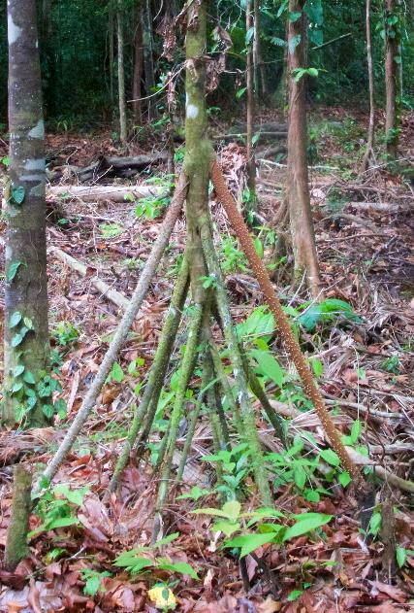

Slide 38
Question 13
Now 2 slides showing the view of the roof of a cave in New Zealand! The bright lights are produced by “glow worms”. They are not actually worms, they are maggots of “fungus gnats”, Arachnocampa luminosa.
The next slide shows one eating a tiny insect. You can see the source of the light in its tail, a close-up of which is on the following slide. Each maggot produces strings of silk, shown in close up on the next slide, which hang from the roof of the cave like fairy lights.
Along each string are many tiny droplets of mucus, each of which glows with the light produced by the maggot’s tail. These glowing “pearls” of light attract small insects which get stuck in the mucus. The maggot then hauls up the insect like a fish on a line and eats it. The source of the light for all these pearls is the glowing tip of the maggots tail, this contains luciferin, a protein that can glow, luciferase, an enzyme, and ATP.
Together these react to produce the light:

Slide 44
Question 13
The silken threads carry the light from the insect tail to each mucus drop. Can you suggest what special characteristic the silken threads must have to achieve this? (1 Point).
To work effectively this method of catching prey needs complete darkness. But it also requires another characteristic of the caves where it lives, the complete absence of one other environmental variable. Can you suggest what this is and why it would prevent the maggot catching its prey? (2 Points)
The last slide of the “glow worm” shows a large maggot eating a smaller one. It is being cannibalistic! They only act in this way when ……………… (complete the sentence) (1 Point)

Slide 45
Question 14
2 Points
The next slide shows a wrybill, Anarhynchus frontalis, a bird only found in New Zealand. Its bill is unique, not seen in any other bird species
alive or extinct. It curves to one side!
Like other curved bills this may be useful to gain access to spaces between pebbles on a shingle beach where small insects and other food items may be found. But, what advantage can you suggest in this type of feeding that a side curved bill would have over an upward or downward curved bill?

Slide 46
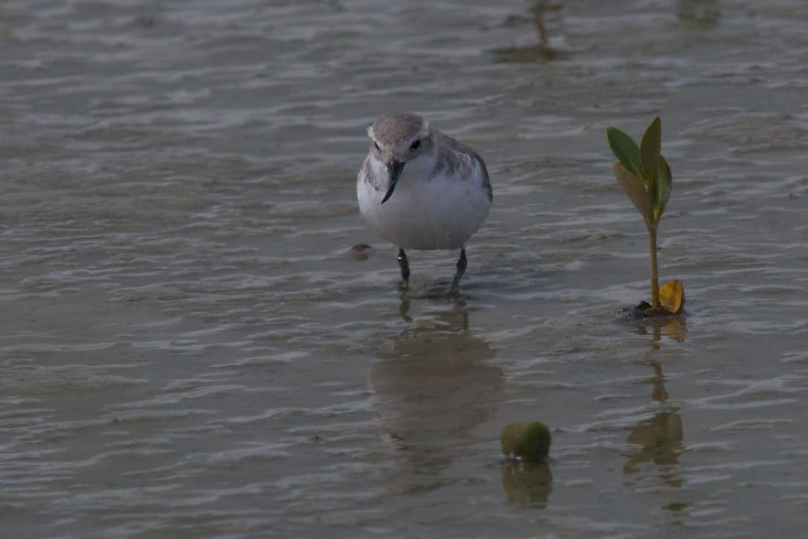

Slide 47
Question 15
First a slide of a small grasshopper. Note its very large rear legs that have very powerful muscles to enable it to jump. All insects that have to jump will show this characteristic.
The next four slides show the males of two species of a group of spiders, the Salticidie or jumping spiders. They can jump several times their own body length, for example on to the back of much larger spiders, which they can then kill and consume. Their ability to jump is comparable to that of the grasshopper!
All their eight legs are of similar size, not at all like the grasshoppers. This is because when extending their legs to jump they do not use muscles in their legs:

Slide 53
Question 15
Can you suggest how these spiders rapidly extend their legs without the use of leg muscles? (1 Point)
By observing the slides can you say why we can be fairly sure that these species see in colour. (1 Point)

Slide 54
ANSWERS
Any answer that shows good logical thinking, even if completely wrong but reflects the current stage of knowledge and understanding in biology should be given the point/s
Q1. Signal to predator to chase thereby protecting offspring or signal to con-
specific competitor/aggressor of submission, or signal for rest of herd to
follow to keep together if chased or it could signal to a predator that it has
been spotted or pursuit is pointless due to the fitness of the deer (if the
white rump is moving at speed and energetically).

Slide 55
ANSWERS
Q2 Lynx, because the deer has exceptionally large ears to detect a stealthy predator
Q3 It can because horn = a helix + not a spiral (or is a ‘screw thread’ etc)
Q4
a. Shade, windbreak, rain guard, keep predators out
b. Chicks can’t fall into and get trapped in crevices
c. Makes chinking noises when walked or slithered over warning of predator approach so adult can escape
d. Makes good nest sites easy to find
e. Respiration of food and directly from fluids in the prey.

Slide 56
ANSWERS
Q5 The moth breeds in lowland areas a long way away, (more than a 1,000
km actually) and adults migrate to the cool alpine region for the summer.
Q6 Frog (actually a ‘leaf frog’!)
Q7 Sites where they are born are inaccessible/difficult to access to predators
such as foxes.
Q8 Crocodile

Slide 57
ANSWERS
Q9 They both flower before leaves appear therefore making the bright flowers much more conspicuous
Q10.
a) Pattern depends on the size and shape of the embryo/foetus at the time the gene/genes is/are switched on, this affects rates of diffusion of various synergistic/antagonistic reactants that lead to melanin production, (for example if the embryo is very small, diffusion across the skin is very rapid and too fast for Turing diffusion to generate a pattern, so very small mammals never have a complex pattern; equally if the genes are switched on when the foetus is large, again Turing diffusion can’t do its magic, so very large mammals such as elephants also never have complex patterns) there is still a lot of debate around this and the full mechanism is not determined!
b) diffusion (actually ‘Turing diffusion’, possibly!)

Slide 58
ANSWERS
Q11
a) They would have used all their energy reserves and would effectively
‘starve’ to death.
b) Leg muscles reflex cause the toes to grip tightly and do not relax. (Or
similar!)
c) Shiver
Q12
Roots on the unfavourable side die and wither, the tree leans towards the
favourable conditions and grows new roots on that side, as these become
firm and support the tree, more roots on the unfavourable side die, and so
on over several years (Or Similar!). This is probably not as effective as
some observers have suggested, but makes for an interesting insight into plant evolution!

Slide 59
ANSWERS
Q13
a) Fibre-optic
b) No wind as this would tangle the hanging threads and make it
impossible to haul in the prey
c) They only act in this way when prey is in short supply and the maggot
could starve, much as tadpoles eat each other if food is in short supply, it makes good ecological sense.

Slide 60
ANSWERS
Q14
Possibly (only possibly!) it enables it to open its beak in the limited space under a stone (there is more space available side to side under a stone than there is up
and down!) OR It enables it to see under a stone as one eye is close to the ground as the stone is lifted. Not really known for sure so any logical answer!
Q15
a)
Blood is pumped from the cephalothorax into the legs extending them under hydraulic pressure
b)
These male spiders are brightly coloured which is probably related to mating behaviour and so the females must be able to see colour

Slide 61
The End

Slide 62
This quiz/presentation is protected by international copyright laws. It may be used, distributed and copied entire for educational/not for profit use without permission from the owner. Use of parts of the quiz or of individual images will require permission.
All such useage and copies of images must carry credit and acknowledgement to Michael Clapham email: mclclapham@gmail.com
Distribution or copying or any other use in a commercial or for profit context without written permission of the owner is prohibited.
Michael Clapham ©2021
The images are low resolution versions of high resolution photographs. These can be purchased from Michael Clapham by emailing mclclapham@gmail.com

