Slide 1
REPORT OF OUTREACH WORKSHOP ON STEM-E USING STEM PLAYCYCLE
IBIYINKA OGUNLADE
DIRECTOR
CHILDREN-IN-SCIENCE & TECHNOLOGY

Slide 2
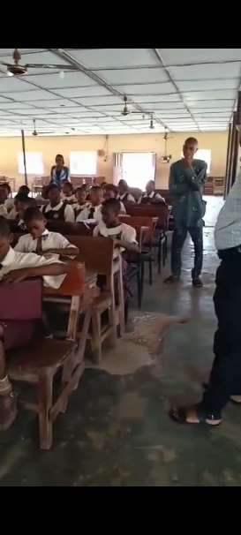
PREAMBLE
In continuation of the impact of the Resource materials donated by FINDEL with respect to CASTME Award.
An Outreach programme was organised for a group of Children within Ikere-Ekiti Community
Comprising 41 girls and 42 boys.
Three STEM related activities were held using STEM play cycle approach

Slide 3
Air has weight
The Children chose balloons according to their favourite color.
without instructions they started blowing air into the balloon creating a lot of funfair.
After some minutes, representatives were asked to narrate their observation.
The Children were able to conclude that air has weight and occupy space.
This was also used to explain the concept of respiration
As well as body organs such as lungs.

Slide 4
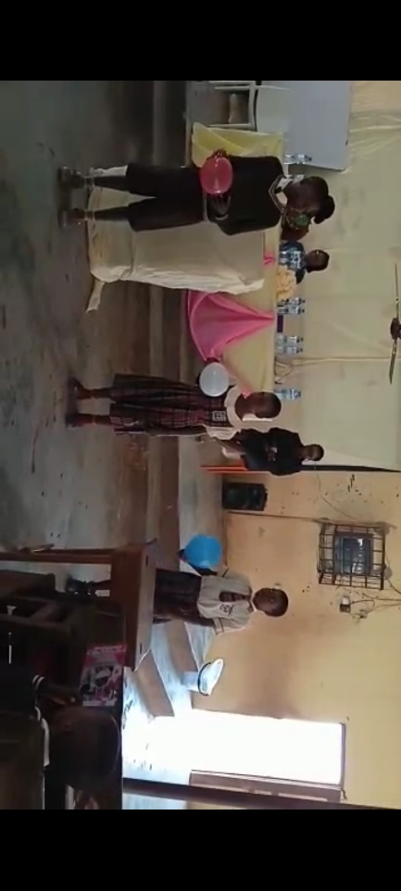
AIR HAS WEIGHT

Slide 5
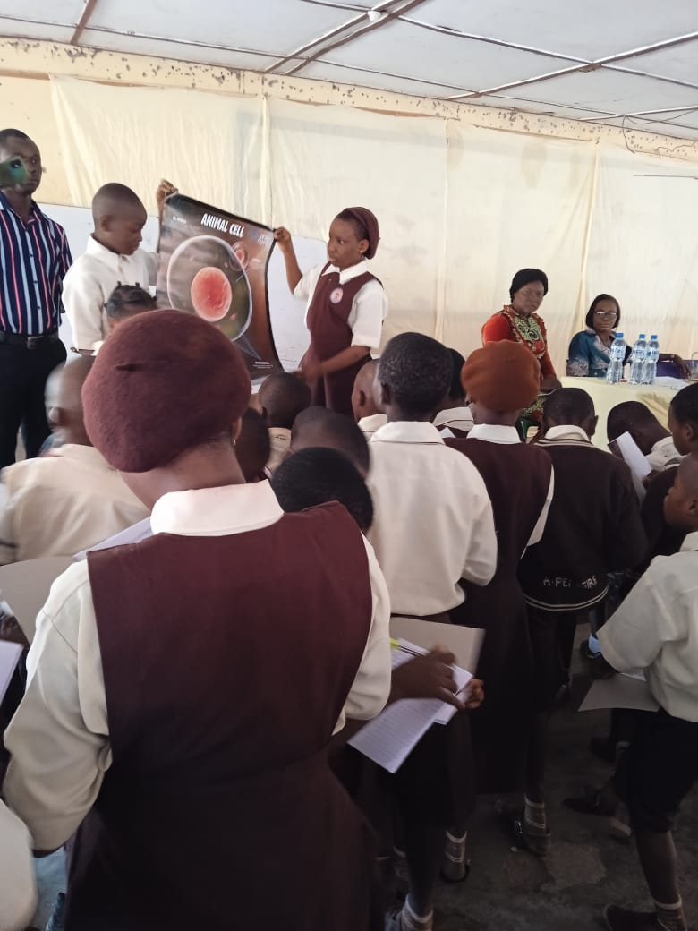
ANIMAL CELL
Animal cell charts, a component of CASTME Award Resources was used
Children learnt that cell is a basic unit of life
There are two types of cell.
Their bodies are composed of millions of cells
Children were instructed to list the components of animal cell and functions as seen in the chart

Slide 6
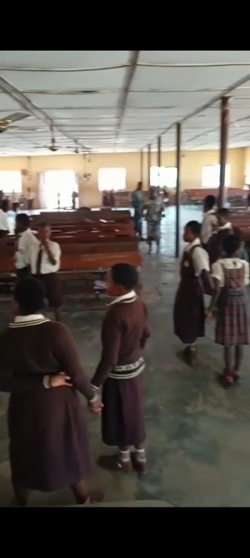
EQUAL FORCES
The concept of force was explained to the children using the method they engage in while playing
Even without knowing they are doing Science.
The children were paired,

Slide 7
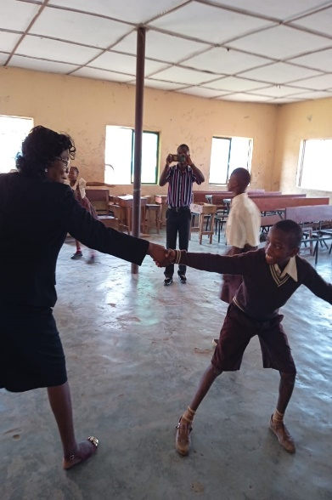
TUG OF WAR
They were instructed to pull each other
The child with the greater force pulled the other.
In cases where they exerted equal forces, they were both at equilibrium.

Slide 8
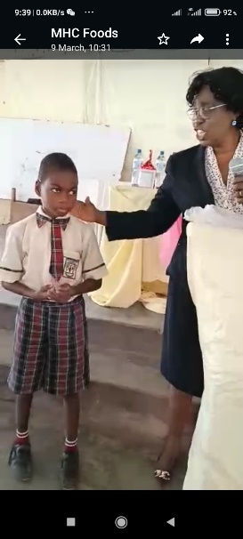
CONCLUSION
The workshop was concluded by presenting a one-session scholarship to one of the pupils

Slide 9
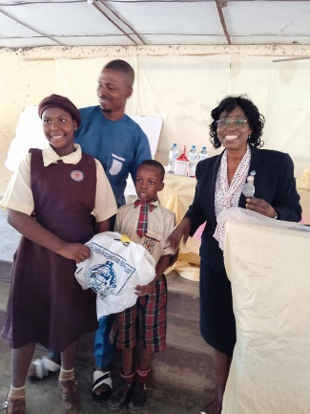
CONCLUSION
In addition to this, gifts were also presented to the most attentive boy and girl- childs during the session.

