Slide 1
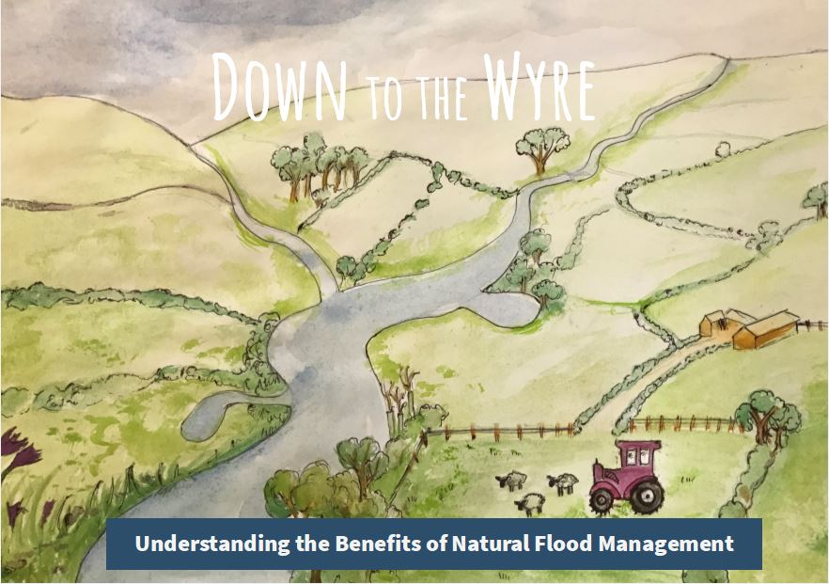

Slide 2
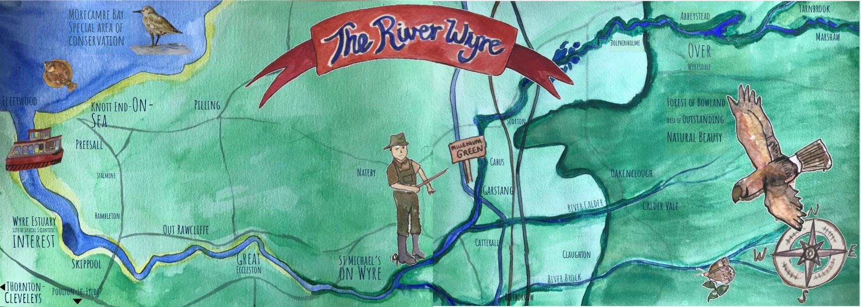

Slide 4
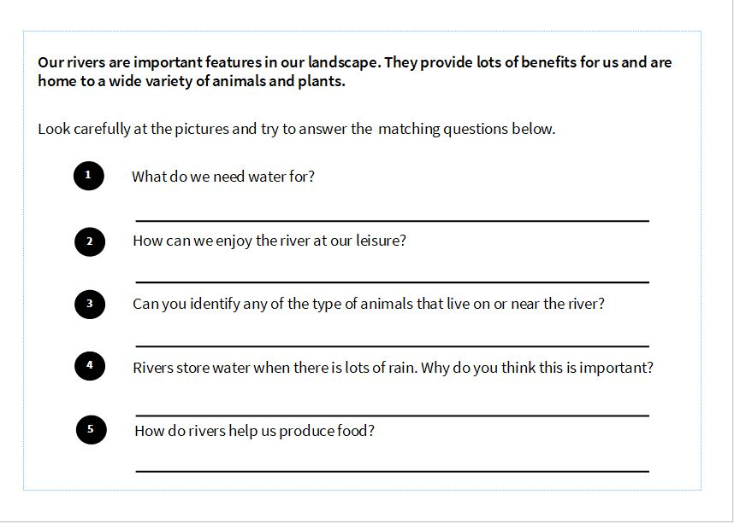

Slide 5
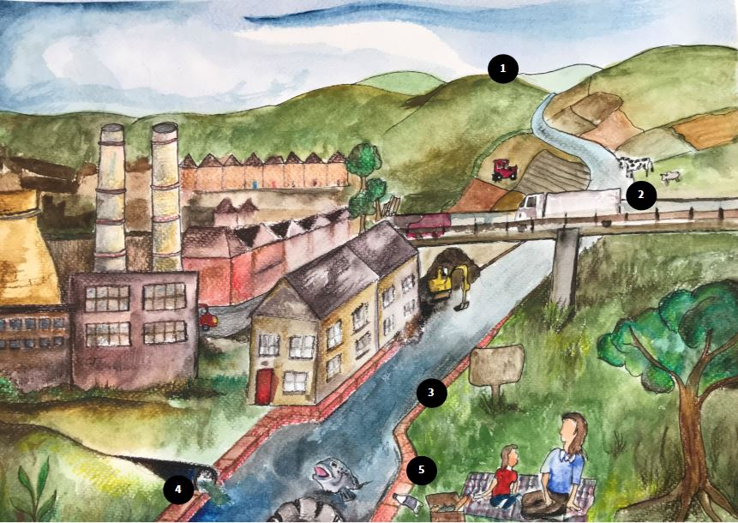

Slide 7
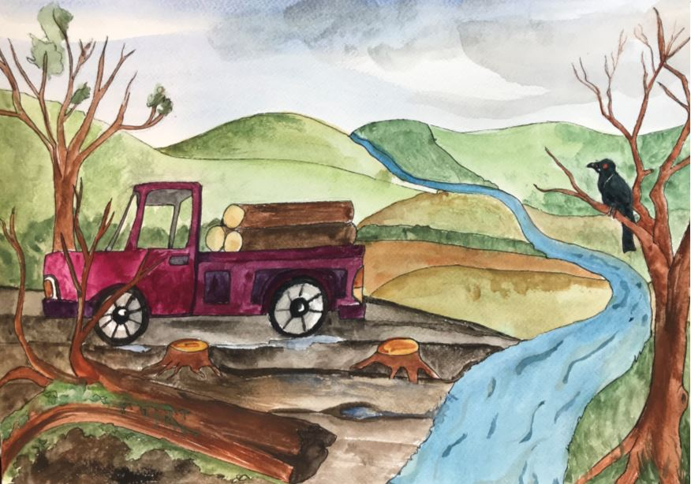

Slide 13
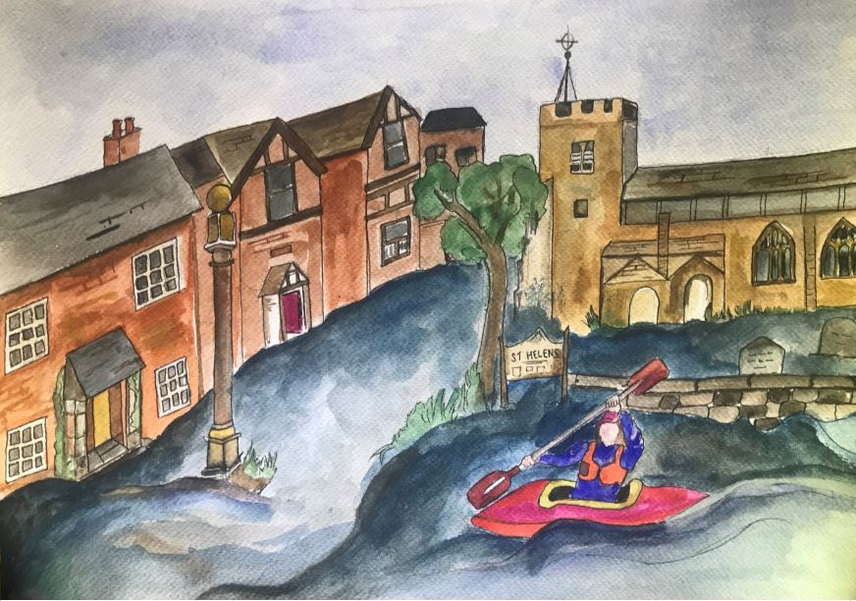

Slide 22
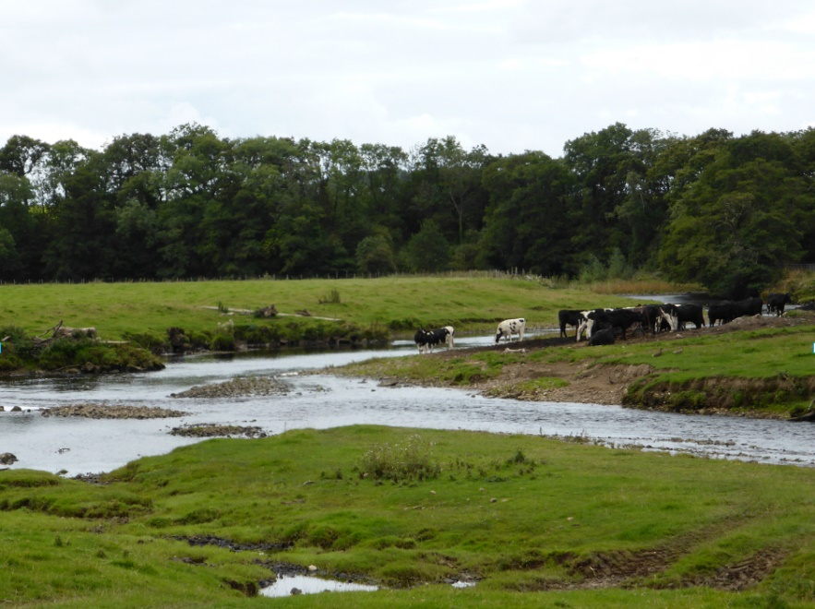
A few years after fencing has been installed vegetation has grown up providing a buffer strip which protects the river banks and filters out pollutants rom rainwater washing off the land and into the river.
Without fencing the bank is poached. There is no vegetation and sediment, poo and other pollutants are washed straight into the river.

Slide 25
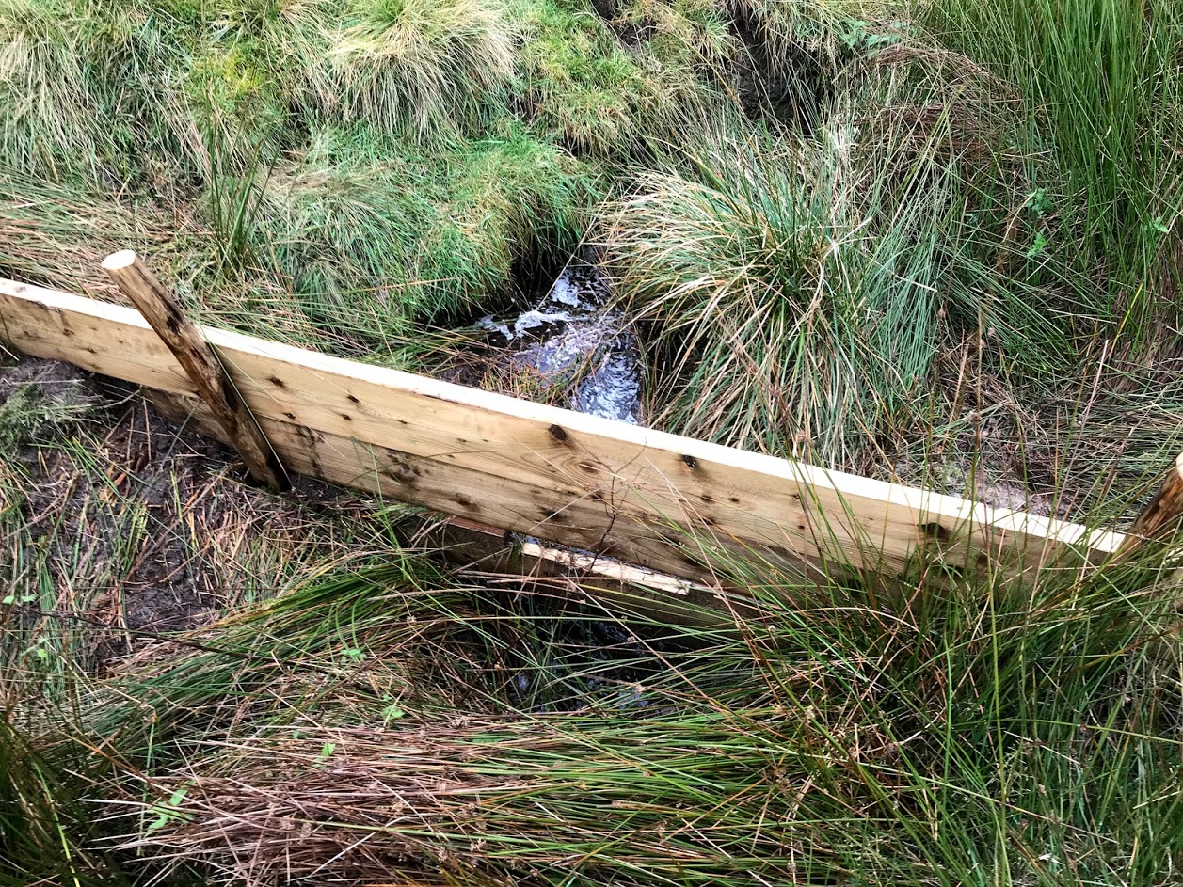
Leaky dam

Slide 28
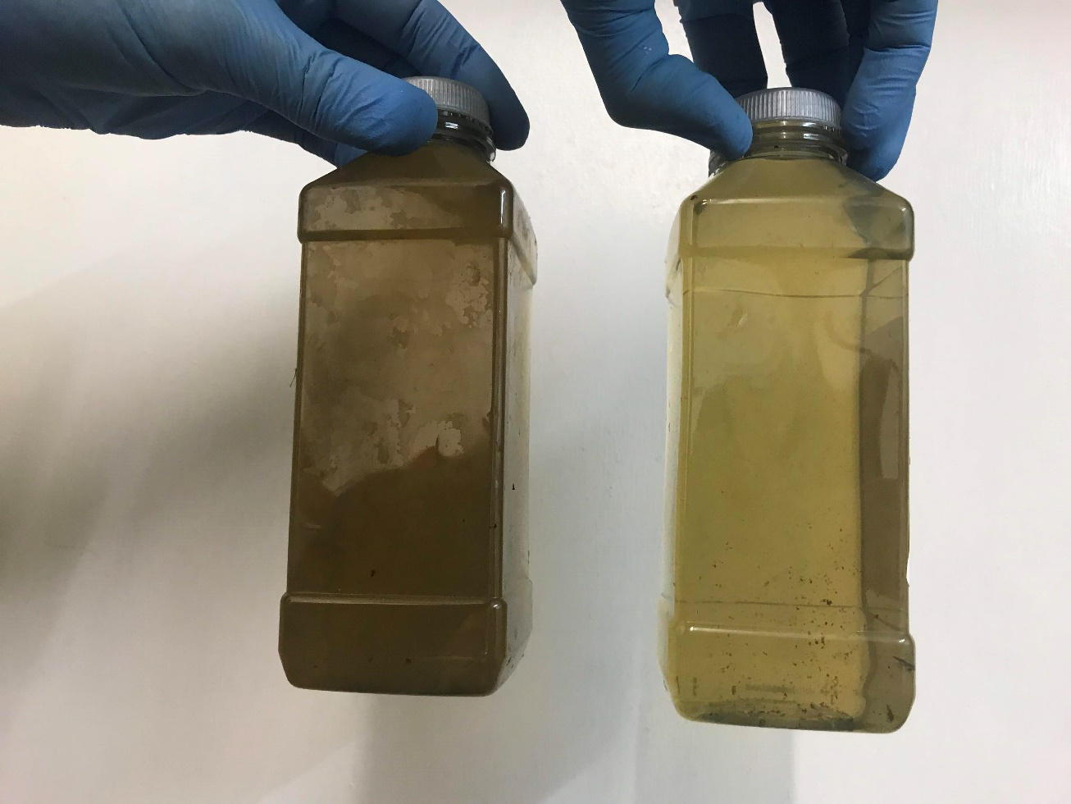
Wetland plants also filter out pollutants. The first bottle shows the water quality where water comes into the wetland. The second shows the water clarity after it has passed through the wetland.
Wetland in the Wyre catchment

Slide 31
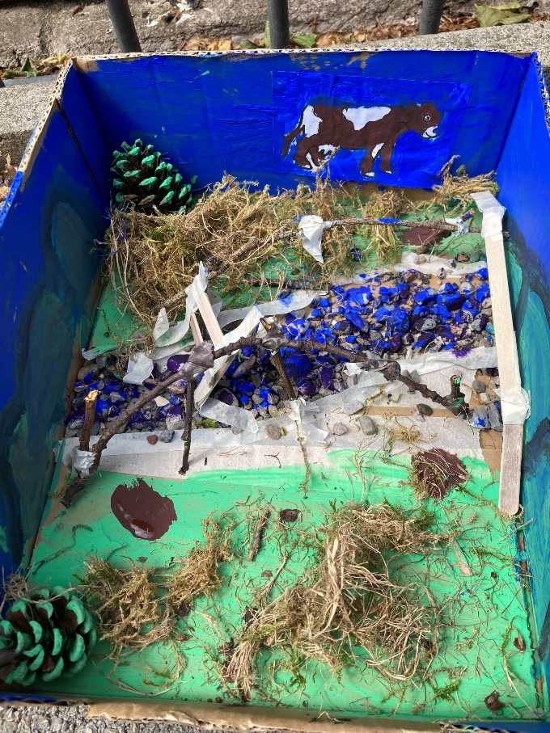
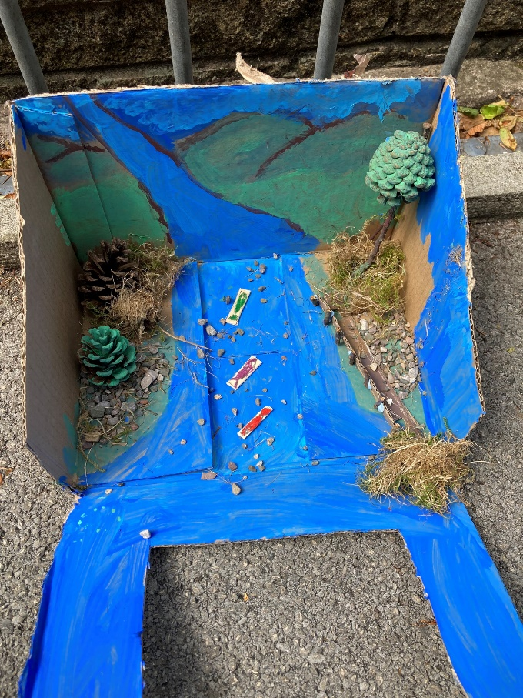
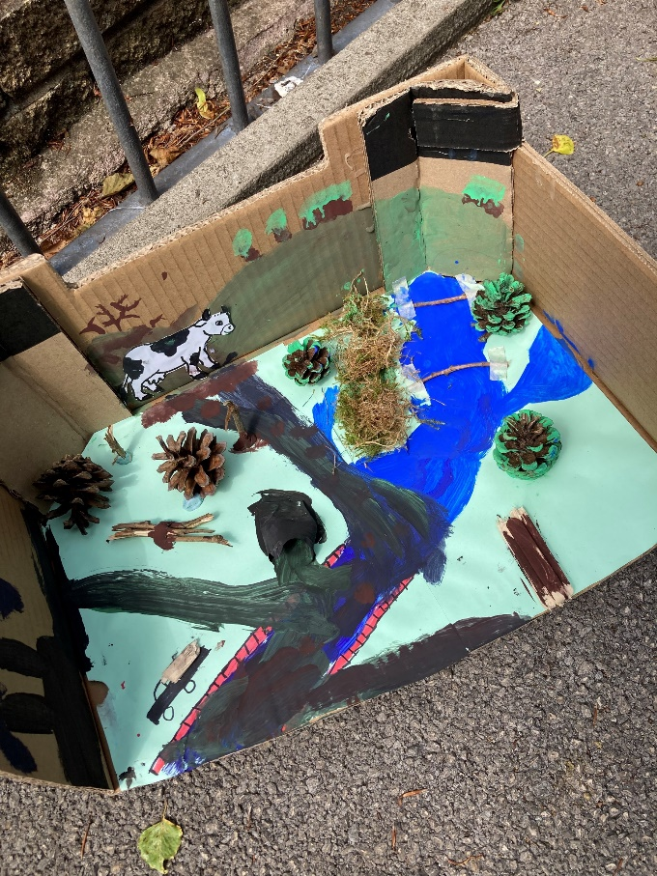
MAKE YOUR OWN DIORAMA
Demonstrate your knowledge of Natural Flood Management by modelling your own diorama demonstrating good practice or bad practice, perhaps both.
You just need some paint , glue and a cardboard box to get started, use natural and recycled materials wherever possible such as twigs, dried leaves and moss, pine cones, lollipop sticks and tiny stones.
Here are some examples made by Key Stage 2 pupils.

Slide 32
