Slide 1

Talk and Do: Science at Home: Everyday Science
CASTME Projects
Commonwealth Association for Science Technology and Maths
Chair: Sue Dale Tunnicliffe
Vice Chair Awards: Kathleen Nugent

Slide 2

.
What is CASTME?
It is voluntary and receives no funding.
Established in 1974 was originally focused on:
Secondary science across the Commonwealth.
Organising regional conferences
Producing journal about science teaching
and learning in the Commonwealth.
Since late 80s also embraced primary science
and informal science and everyday science, science at home.

Slide 3
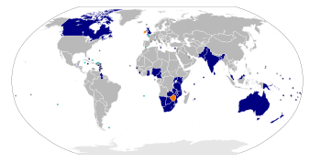
.
The Commonwealth
54 member countries
2 seeking to join
1 seeking readmittance
Head is Queen Elizabeth II
The chief executive of the Commonwealth is the Secretary General elected by member states.

Slide 4
AIMS of CASTME
CASTME
• recognises the crucial role of STEM in
the delivery of the Sustainable Development Goals
• connects educators, of all ages, in formal
and informal settings in the Commonwealth
• recognises that learning is Lifelong and takes many forms.
• actively promotes the importance of both
community and family as the foundation of learning
importance of STEM in everyday lives
• promotes projects in the social and human context
of STEM and the development of critical 21st C skills

Slide 5
Science at home Everyday Science
By home we mean the place where children, live and sleep
But also the area in which they live and observe and experience science in actions.
Such understanding they bring into therein formal school work
as some of the past awards show.
Z

Slide 6
STEM-E. Experiences. The foundations of learning
Actions and experiences are the start in developing everyday Science
-STEM literacy.
STEM-E. experiences - the basis for later formal teaching
fo

Slide 7
Working with parents Communities and pre school children
Working with:
mothers and children in Sreepur Bangladesh
- to help them recognize the science actions in
their everyday lives and talk with their children.
African science educators working with parents
with pre school children and with the communities
Local mother and toddler group

Slide 8
AWARDS sponsored by Findel International 2022 awards announced at this ASE
The Findel CASTME Education Award 2021 Science Laboratory and Science Museum Panadura-Sri Lanka receives equipment and international membership of ASE for 1 yr.
The Findel CASTME community Award Entry 2021 :
Popularising Science and Technology among Children for self-reliance.
Awarded to: Science and Technology (CIST) Ekiti State
University, Ado-Ekiti, Nigeria

Slide 9
NEW SUSTAINABILITY AWARD for 2022
2022 a NEW Award
The Findel CASTME Protect Our Planet Award
for a STEM project which focuses on the
Sustainable Development Goals
such as Climate Change, Responsible Consumption
and Clean Water.
Award details are on CASTME website
www. Castme.online.org and on
CASTME section in Commonwealth INNOVATIONS platform

Slide 10
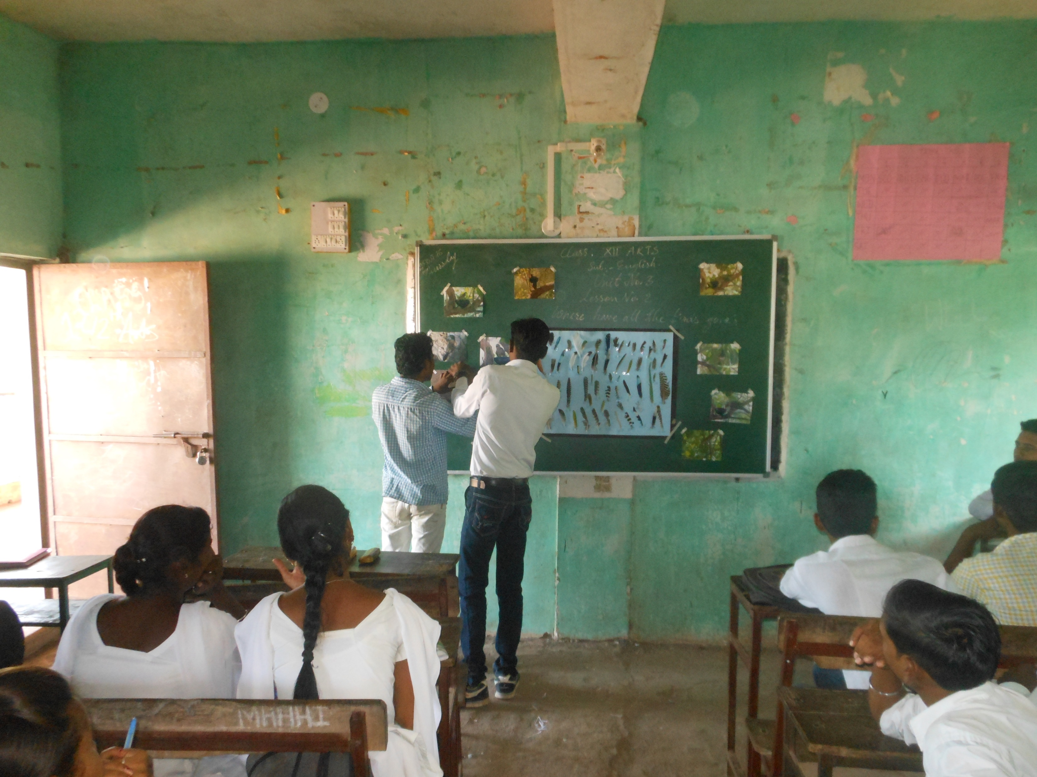
A past award project : Creating indigenous learning resources through Environmental Project work using inexpensive and easily available material in collaboration with teachers and students of Saraswati Junior College, Paras. India
Majority of my students belong to rural area and some actually work in fields. A group chose 'Bird Feathers' as the topic and the whole class helped them. Students brought some colourful feathers in the class. That ignited a new idea of quill collection.
Students searched for quills in and around fields, the winding paths of forests, on the banks of river. While travelling for school, their eyes searched for the colourful tokens of birds. As a result more than five hundred quills were collected of various size, colour and patterns from fields, river side's, trees, abandoned houses and wells. The project was talk of the school. It proved helpful while learning English lessons related with environmental topics.
Feathers: The colourful identity of birds. Rajesh Bhaskar Patil

Slide 11
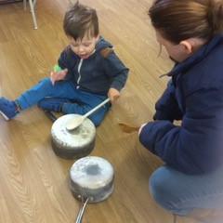
Playing to Learn: Learning to Play
”Science, during early childhood,
is more than play:
It is serious business.
If we fail our children and students
in science, the reasons may include
lack of appropriate
experiences during early childhood”
Wolff-Michael Roth, Maria Ines Mafra Goulart, Katerina Plakitsi
(2013). Science Education during Early Childhood.
A cultural – historical Perspective
Dordrecht, Springer p.14
What happens if…?

Slide 12
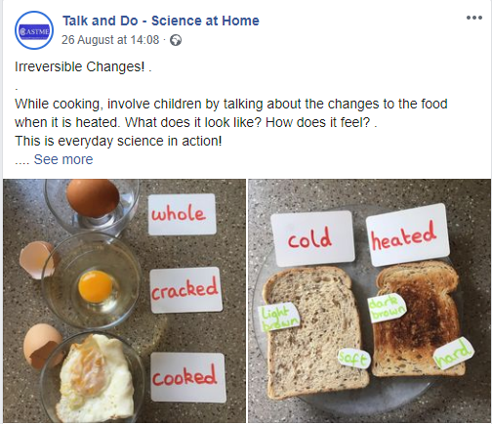
OTHER CASTME ACTIVITIES
RESOURCE HUB in partnership with ASE
based on the edited SATIS resource sheets
updated for relevance and SDGs
ACTIVTY SHEETS For primary children and family

Slide 13
OTHER CASTME ACTIVITIES
FACEBOOK https://www.facebook.com/Talk-and-Do-Science-at-Home-116167663504654/
INSTAGRAM @castmeactivities
Photographs of Everyday phenomena or situations with a cue Question - developed at request of Mothers in. UK at start of pandemic
Other CASTME groups developing their own
Digital literacy

Slide 14
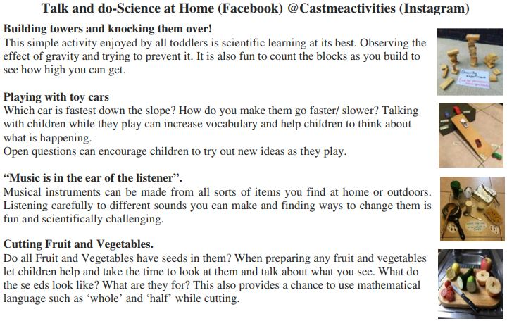

Slide 16
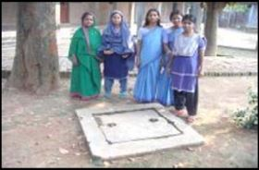
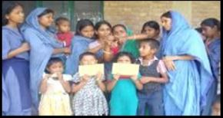
Mothers Talking Every Day Science project. Sreepur, Bangladesh
    Learning about temperature and how to take theirs
This shape is a
square:
4 equal sides
4 right angles.
Sreepur is a purpose built village for destitute women and their children where the mothers learn a skill such as sewing, so they can return to their community and earn a living supporting themselves and their children. This CASTME project aims to encourage the mothers to learn about everyday science and technology in their lives and talk with their children about it. Most of the women received little, if any, school education. The mothers have made Big Books from the paper they make as one of the trade activities of Sreepur, print out photographs they take of what interests them, Hoping to use digital literacy to for similar and facilitate sharing with children and others.

Slide 17
CASTME
Produces a regular newsletter posted on website sent to emails on request.
Acts as an umbrella for STEM in the Commonwealth
Trustees meetings three times a year
Monthly informal meetings for members on Zoom
Attended by members of CASTME groups around the Commonwealth
Hosted by a Colleague in Canada.

Slide 18
Founded 1974

